Slide 1
Monitoring Of Terpene Emissions
From Pine Trees By Auto-TDGCs
Chromatotec®
info@chromatotec.com
Contact : louis.vivola@chromatotec.com

Slide 2


Slide 3
Outline
Introduction
Instrument presentation
Laboratory study
Field study
Conclusion

Slide 4
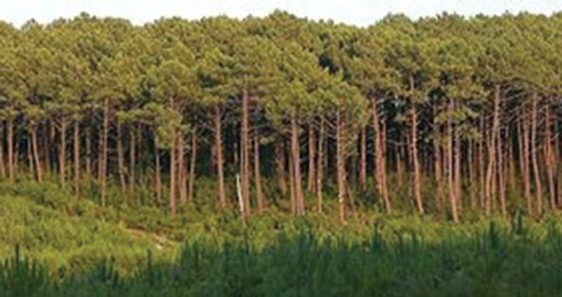
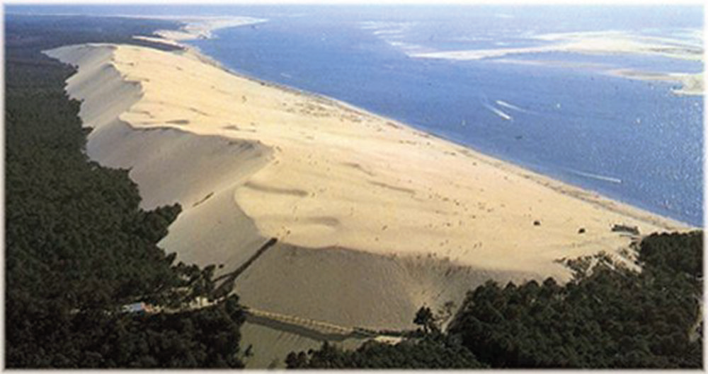
Introduction
Organic aerosols (OA) makes up a major fraction of fine particulate matter in all region of the atmosphere. This fraction accounts approximately for half of the total PM2.5 dry mass
Primary OA is directly emitted in the troposphere from anthropological and natural sources

Slide 5
Introduction
Secondary OA (SOA) is formed in-situ in the atmosphere from the oxidation of biogenic or anthropogenic gas-phase precursors and subsequent partitioning of the less volatile products into the particle phase.
  Continuously measure the concentrations of specific VOC emitted by the maritime pines of Landes Forest.
  The cycle time must be short enough so that the kinetics of emissions can be monitored.
  Also, the types of MT must be identified and quantified accurately.

Slide 6
Outline
Introduction
Instrument presentation
Laboratory study
Field study
Conclusion

Slide 7
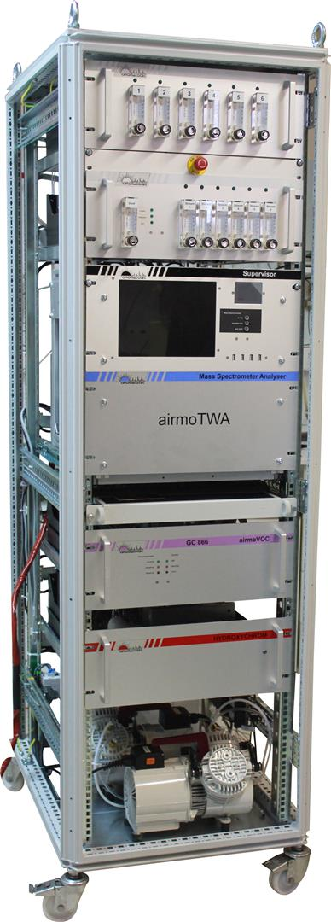
Instrument presentation
For the laboratory phase
  an automatic thermal desorption gas chromatograph, equipped with a Flame Ionisation Detector (airmoVOCXpert from Chromatotec®) and a Mass Spectrometer (DET QMS from Chromatotec®) was used to characterise the different compounds emitted by maritime pines and to establish the complete list of compounds to be monitored during the field campaign. The list will be used to create the substance table needed in the auto-GC.

Slide 8
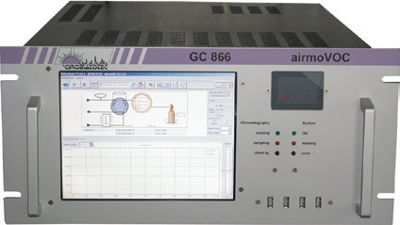
Instrument presentation
The analytical system used for the field measurements
  an automatic thermal desorption gas chromatograph equipped with a Flame Ionisation Detector (airmoVOC C6-C12 from Chromatotec®), an air generator for the flame of the FID and valve actuation (airmopure from Chromatotec®) and a hydrogen generator 99.9999% (Hydroxychrom from Chromatotec®). The integrated TD device comprises a one phase trap specifically chosen for Terpenes analysis.

Slide 9
Outline
Introduction
Instrument presentation
Laboratory study
Field study
Conclusion

Slide 10
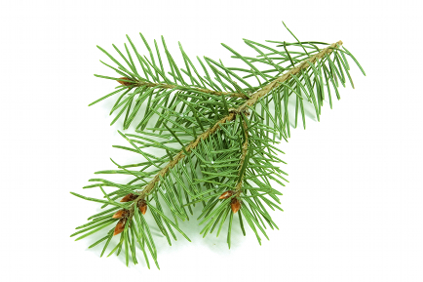
Laboratory study
To optimise the method for terpenes measurement, the first step was to know what species to expect. Therefore, we collected broken pine twigs and pine needles and placed them in a glass container for laboratory analysis.

Slide 11
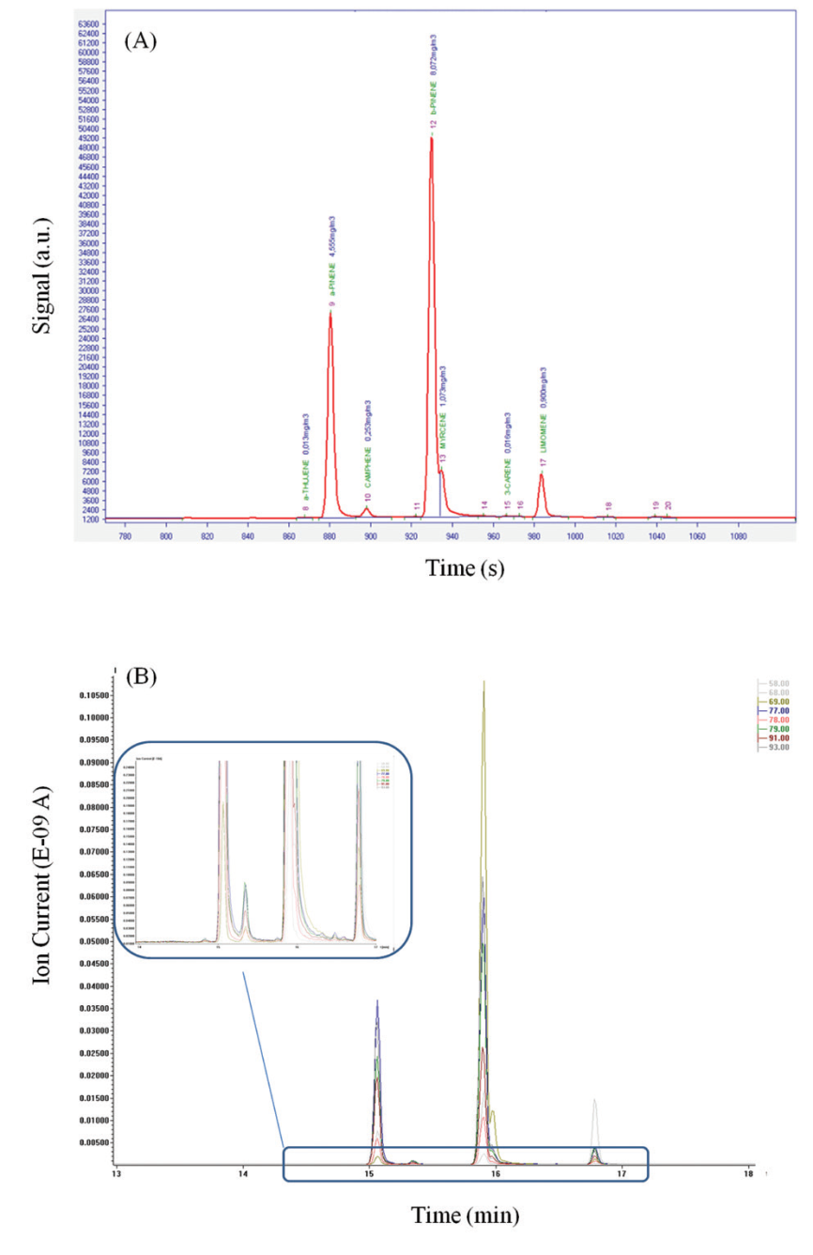
Laboratory study
α-pinene and β-pinene represents 84% of the
overall Terpenes mass analysed from broken pine twigs and pine needles.

Slide 12
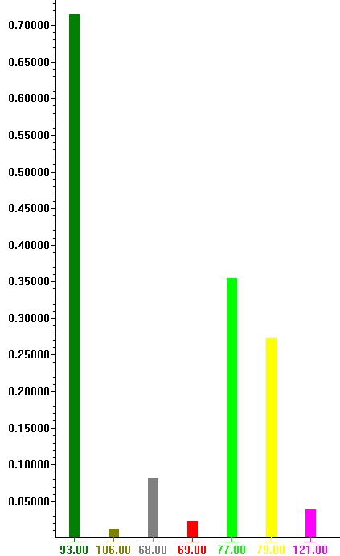
Peak 1: α-pinene
m/z | % exp
93 | 100
106 | 3
68 | 11
69 | 4
77 | 41
79 | 31
121 | 6

Slide 13
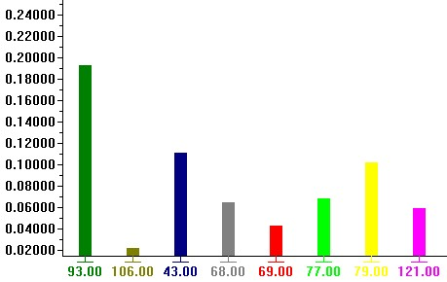
Peak 2 : Camphene
m/z | % Exp
93 | 100
106 | 11
43 | 57
68 | 34
69 | 22
77 | 35
79 | 53
121 | 31

Slide 14
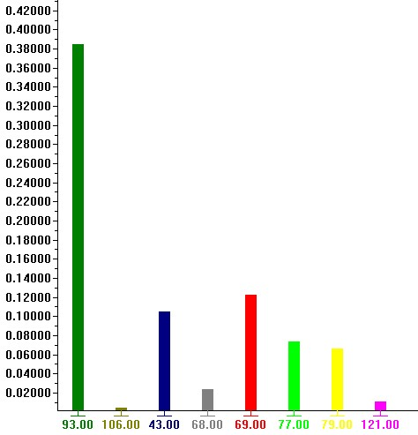
Peak 3 : β-pinene
m/z | % Exp
93 | 100
106 | 3
43 | 48
68 | 10
69 | 55
77 | 39
79 | 35
121 | 7

Slide 15
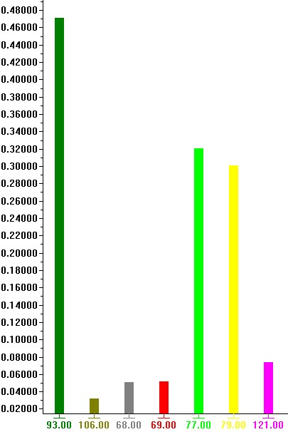
Peak 4 : 3 carene
m/z | % Exp
93 | 100
106 | 20
68 | 27
69 | 26
77 | 52
79 | 44
121 | 24

Slide 16
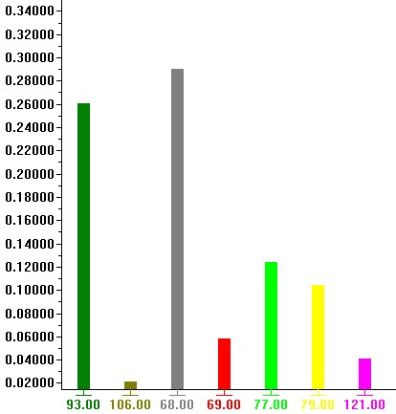
Peak 5: limonene
m/z | % Exp
93 | 56
106 | 7
68 | 100
77 | 30
79 | 34
121 | 14

Slide 17
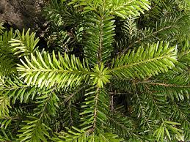
Laboratory study
To optimise the method for terpenes measurement, the first step was to know what species to expect. Therefore, we collected broken pine twigs and pine needles and placed them in a glass container for laboratory analysis.

Slide 18
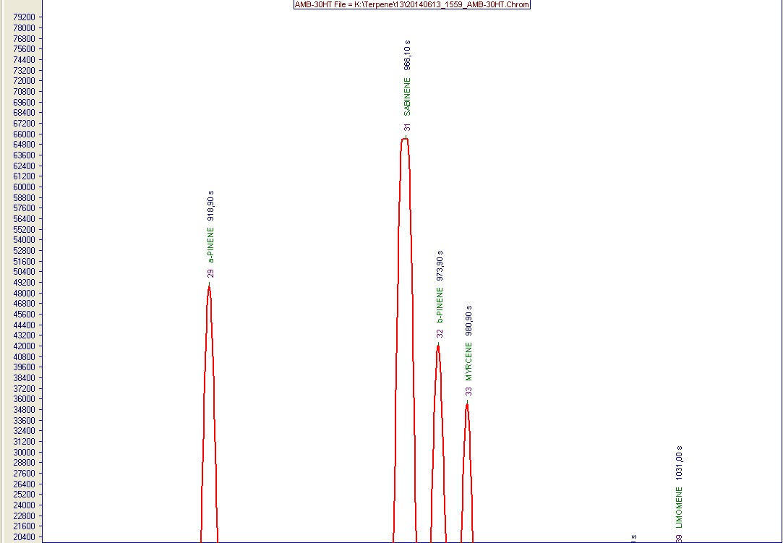
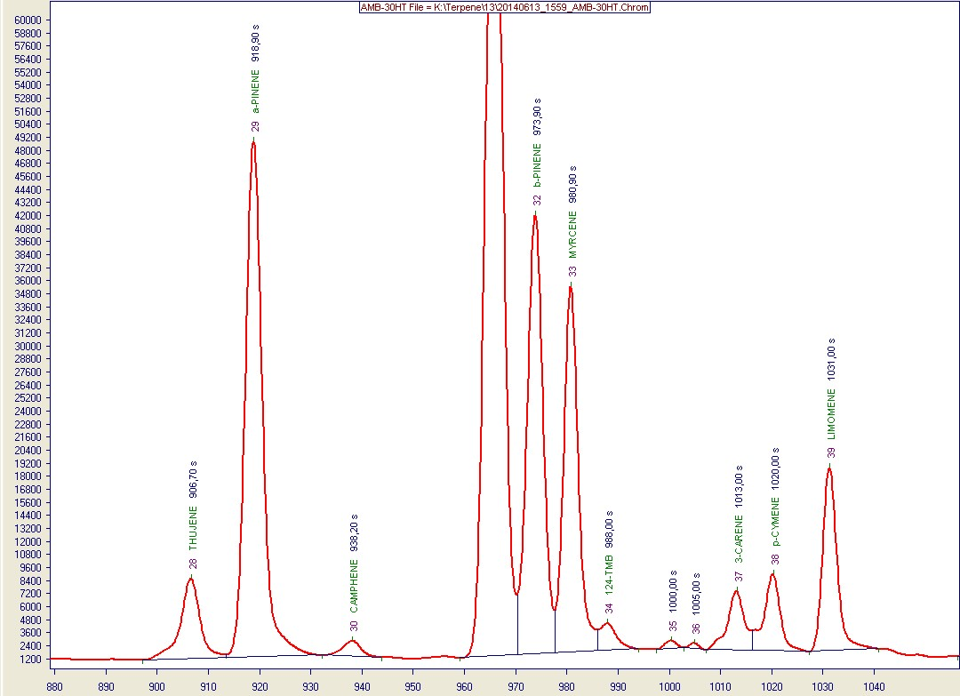
Laboratory study

Slide 19
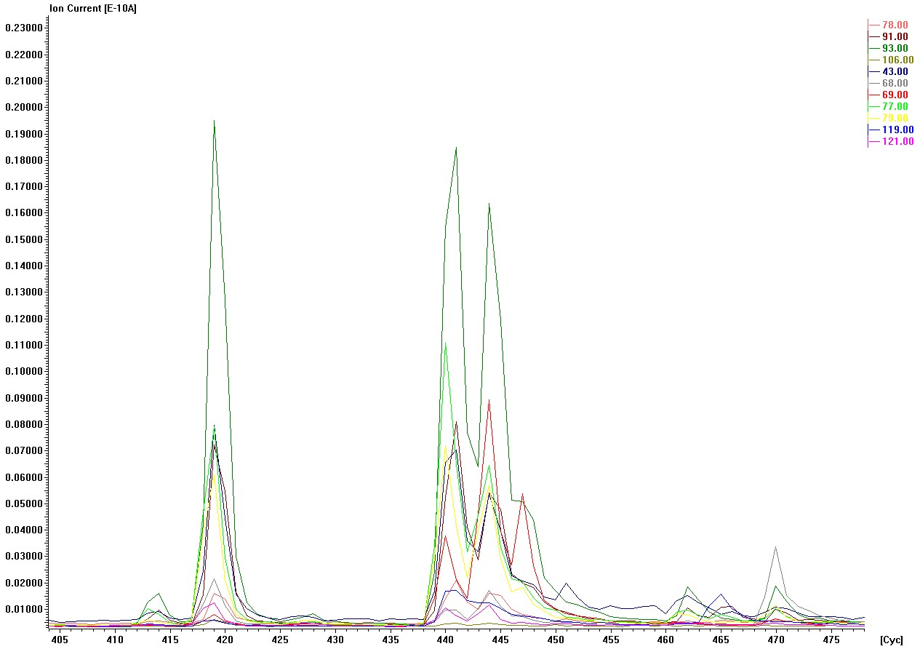
Laboratory study
Identification de 3 nouveaux pics
Identification of 2 new compounds + Thujen

Slide 20
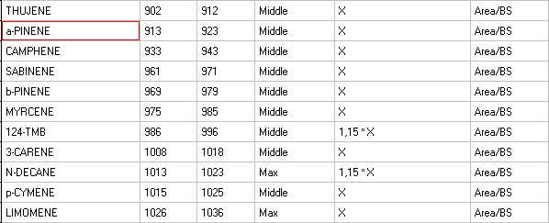
Laboratory study

Slide 21
Outline
Introduction
Instrument presentation
Laboratory study
Field study
Conclusion

Slide 22
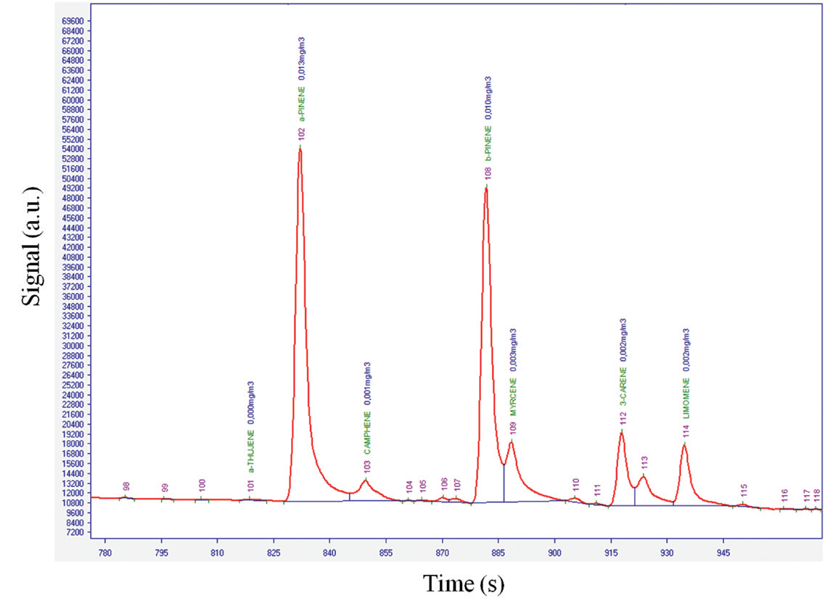
Field study
50 km from the sea
The main compounds measured are α-pinene, camphene, β-pinene, 3-carene and limonene. α- pinene and 3-carene are the most concentrated compounds monitored in the forest.

Slide 23
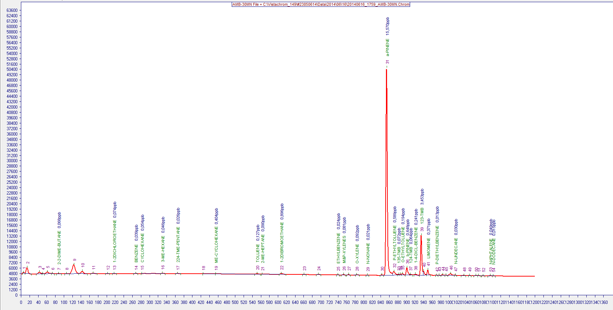
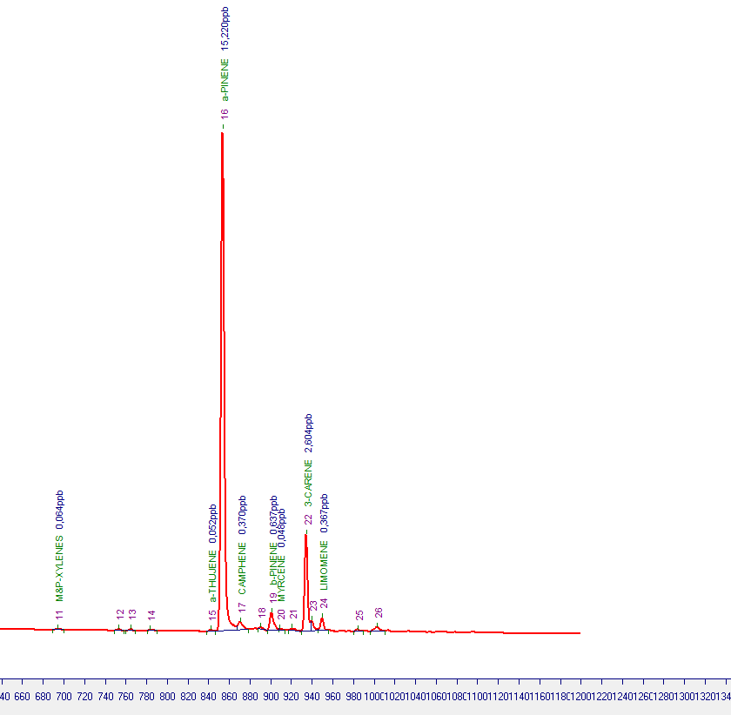
Field study
50 km from the sea
Terpens are the main VOCs emitted near the landes forest

Slide 24
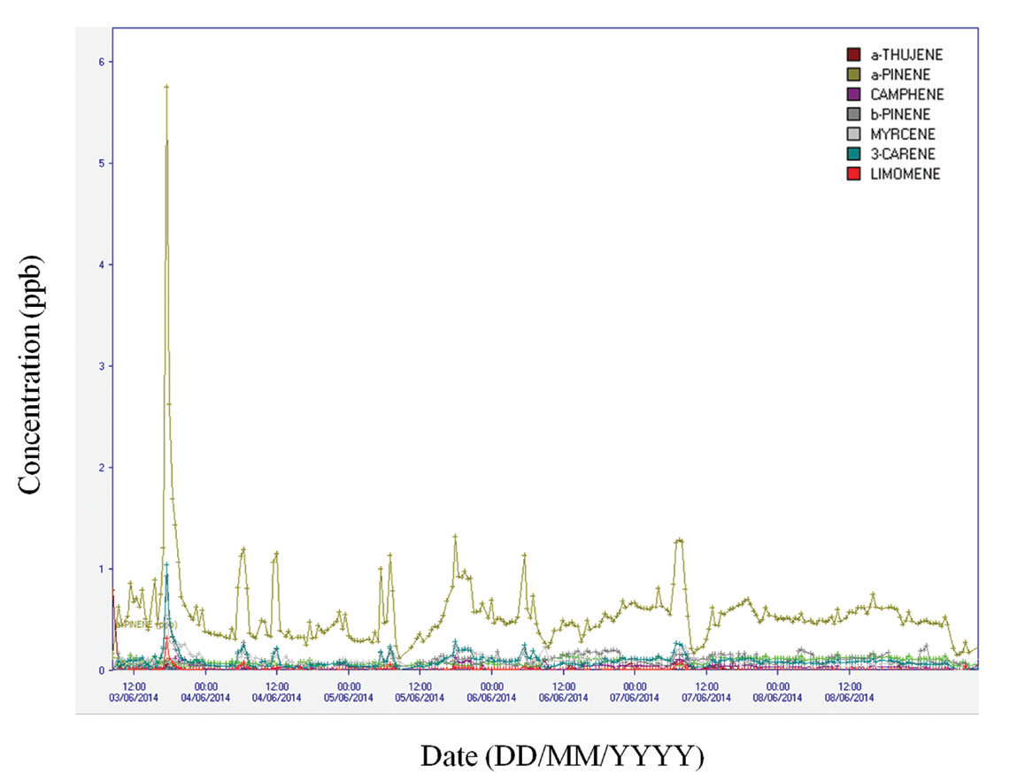
Field study
50 km from the forest
α- pinene represents 58% of the overall MT mass measured with a concentration varying from 0.72 to 32.7 μg/m3

Slide 25
Conclusion
Laboratory study
  Terpenes can be identified and quantified
Terpenes can be monitored
  α- pinene represents 58%
  0.72 to 32.7 μg/m3

Slide 26
Conclusion
It was possible to identify and quantify accurately the levels of α-thujene, α-pinene, camphene, β-pinene, myrcene, 3-carene and limonene emitted by maritime pines trees.
Other MT have been analysed in laboratory but were not measured with the pin trees.
Chromatotec solutions are clearly designed to follow the concentration variations of each Terpenes with a cycle time of 30 minutes.

